Slide 1

COGENTIX HR ANALYTICS CASE STUDY
TOOLS USED
PRESENTED BY:
Pandas, Statsmodels, Scikit-learn, LightGBM, Streamlit Dashboard
Jei Akash M A
Mithun V R

Slide 2


Q1 Engagement: | What factors drive low employee engagement? Are demographics, tenure, performance, or compensation linked to low engagement?
Q2 Promotion Readiness: | Can we build a fair, leakage-free predictive model to identify promotion-ready employees?
Q3 Performance Drivers: | What influences high performance? Are training hours, salary, tenure, or demographics linked to performance?
Q4 Compensation vs Performance: | Does pay (salary & bonus) align with employee performance across departments and roles? (Dashboard: Competition)
Q5 – Managerial Impact: | Which managers significantly contribute to low engagement? Who needs HR intervention?
Project Overview: Business Questions Addressed

Slide 3
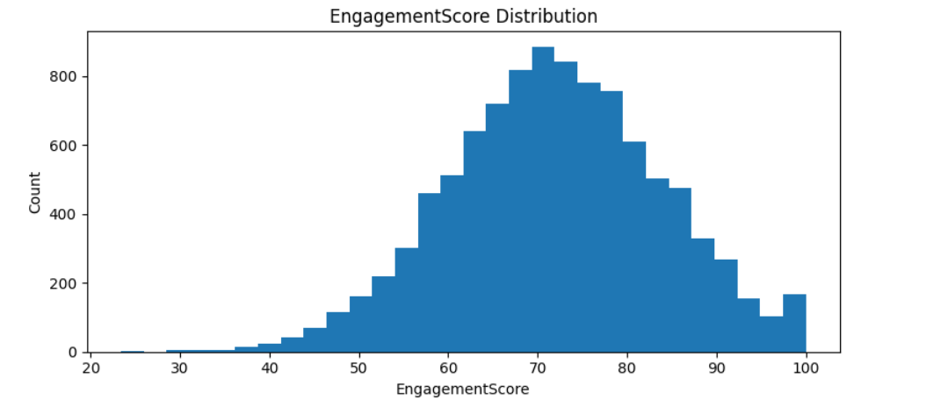
Q1: What Drives Low Engagement? (Problem Definition)
Objective
Identify whether demographics, compensation, performance, or tenure explain low engagement.
Definition
low_engagement = EngagementScore ≤ 63.9 (25th percentile)
Methods Applied
Chi-square tests
Cramér’s V effect size
Mann-Whitney tests
Logistic regression (multivariate)
RF & LightGBM models

Slide 4
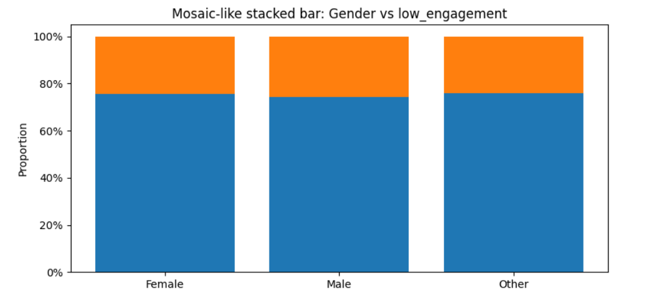
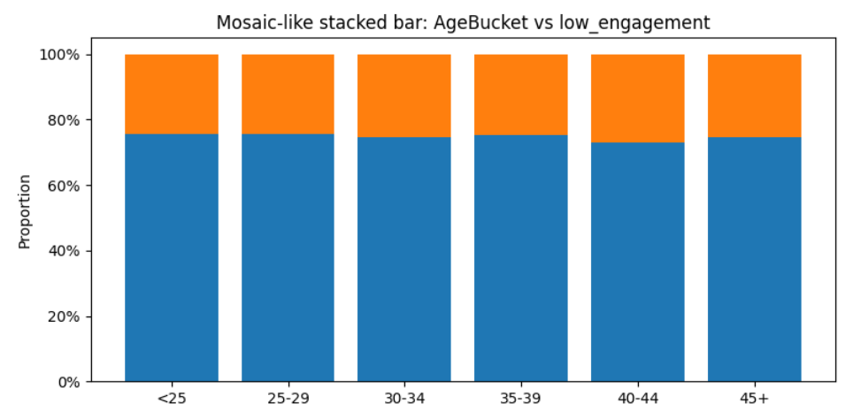
Q1: Demographic Patterns (Chi-square Tests)
Chi-square Results
Interpretation | Attribute | p-value | Effect
❌ Not significant | Gender | 0.427 | V=0.013
❌ Not significant | AgeBucket | 0.638 | V=0.018
❌ Not significant | Location | 0.940 | V=0.018

Slide 5
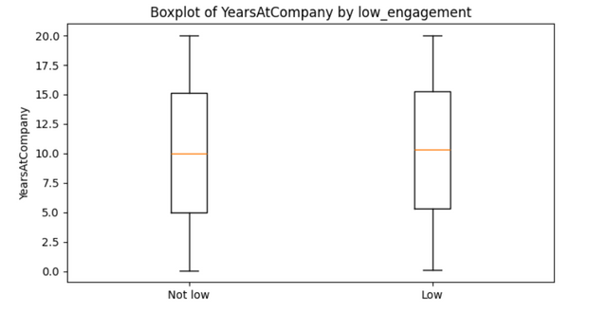
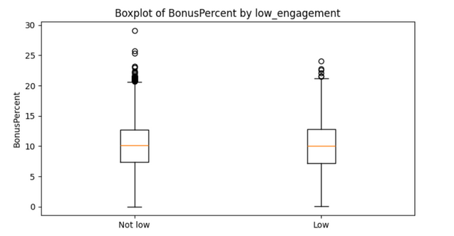
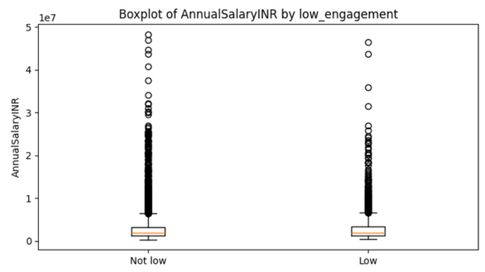
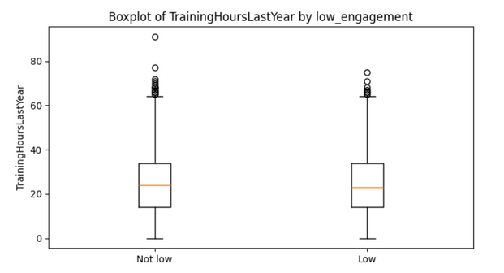
Q1: Numeric Factors (Mann-Whitney, Effect Size)
Factors compared:
Salary, Bonus
YearsAtCompany
Age
Performance
Training Hours
Conclusion
Result:
Salary, bonus, training hours, tenure do NOT significantly distinguish low vs high engagement employees.
All tests: p > 0.05
Cohen’s d ≈ 0.0–0.03

Slide 6
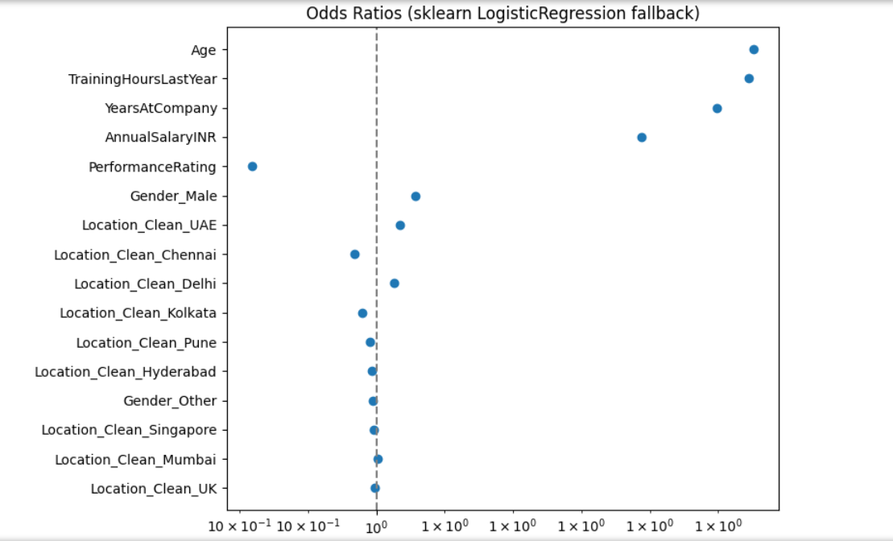
Q1: Multivariate Logistic Regression
Variables Used
Age, Gender, Location, Salary, Tenure, Performance, Training
Outcome
-All odds ratios ≈ 1.0
All p-values > 0.1 (except intercept)
Conclusion
➡️ Engagement is not driven by demographic or role-independent features.
➡️ Points toward team/manager context.

Slide 7
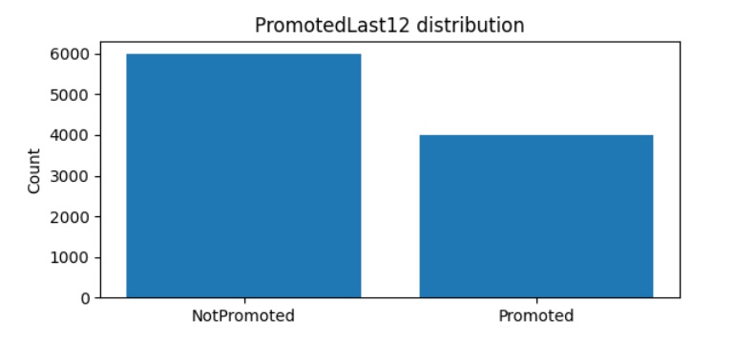
Q2: Promotion Readiness (Problem Definition)
Objective
Build a fair, leakage-free model predicting whether an employee is promotion-ready.
Target Created:
PromotedLast12 = 1 if LastPromotionMonthsAgo ≤ 12
Constraints
NO leakage
NO using LastPromotionMonthsAgo directly
NO manager aggregates from target
Must be explainable & fair

Slide 8
Q2: Models Tried (and Dropped Due to Leakage)
Dropped Approaches:
Using LastPromotionMonthsAgo as a feature
Creating mgr_prom_rate, mgr_avg_perf, etc.
Using models with AUC ≈ 1.0 → impossible & leaky
Attempted SHAP/permutation on misaligned feature sets → failed
Why Dropped
These models “peeked into the future,” making them invalid for HR fairness and auditability.

Slide 9
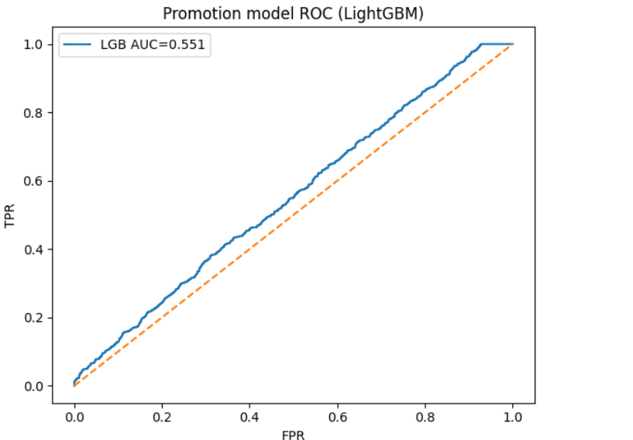
Q2: Final Valid Modeling Approach
Leakage-Free Method
Removed all target-derived features
One-hot + standardized numeric features
Added safe engineered features (SalaryRolePct, SalaryDeptPct)
Performed 5-fold cross validation
Added OOF Target Encoding for high-cardinality:
ManagerID, Department, Role
Added interaction features
Why This Works
✔ Fair
✔ Non-leaky
✔ Captures manager/role patterns without cheating

Slide 10
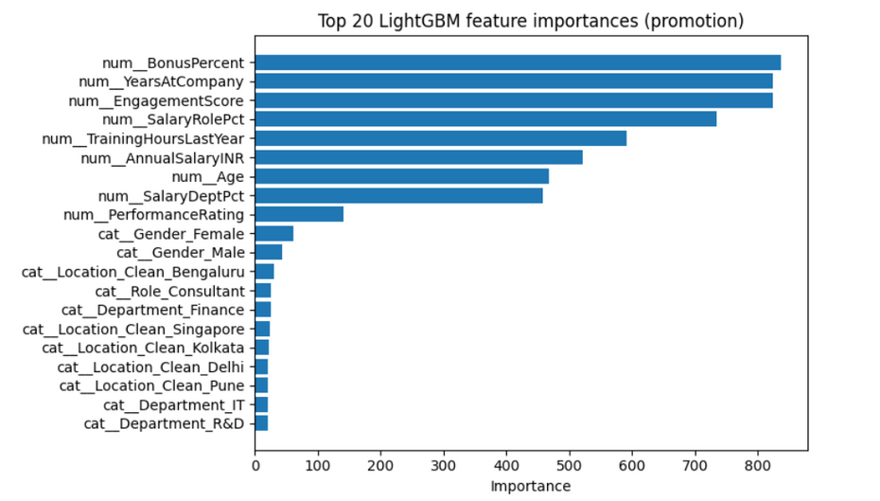
Q2: Model Performance Summary
LightGBM CV Results (Final):
AUC ≈ 0.54
PR-AUC ≈ 0.43
Precision@Top10% ≈ 0.45–0.50
Interpretation:
Promotion decisions are complex → data lacks clear signals
Some signal captured through tenure, salary percentiles, and encoded manager factors
Top Features:
BonusPercent, EngagementScore, YearsAtCompany, SalaryRolePct

Slide 11
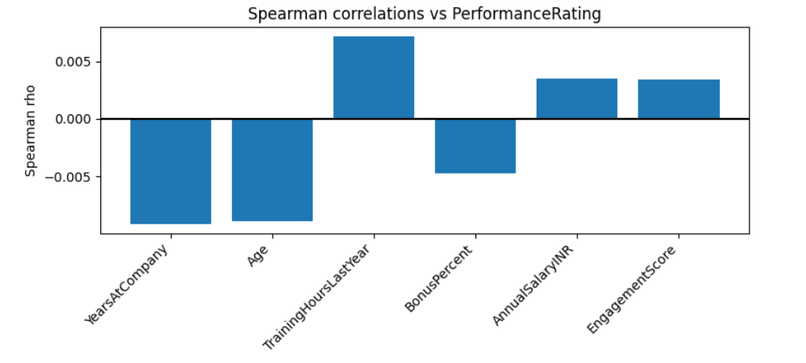
Q3: Performance Drivers (Setup)
Objective
Identify which factors influence high performance (PerformanceRating ≥ 4).
Methods
Heatmaps for Training × Tenure interactions
Spearman correlations
Kruskal-Wallis tests
Logistic Regression
Random Forest

Slide 12
Q3: Correlation Results
Spearman Correlations
Factor | ρ | p-value
TrainingHoursLastYear | +0.007 | 0.47
YearsAtCompany | -0.009 | 0.36
Salary | +0.003 | 0.72
BonusPercent | -0.004 | 0.63
EngagementScore | +0.003 | 0.73

Slide 13
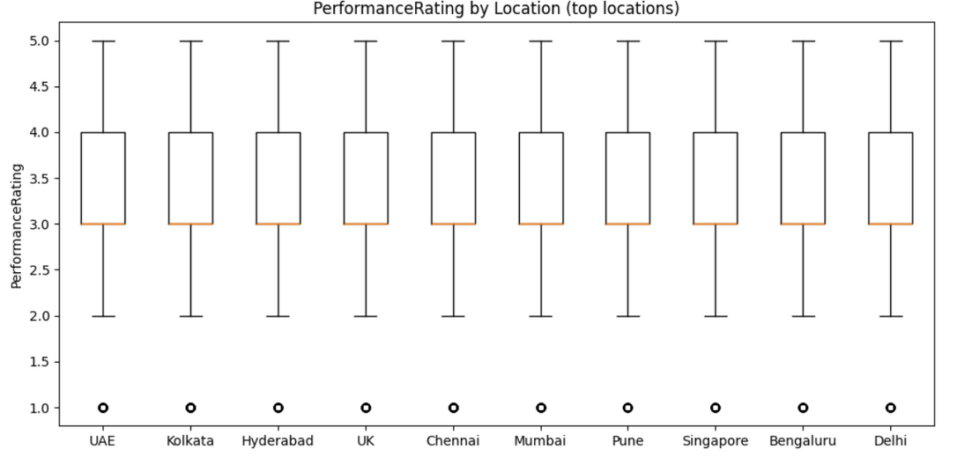
Q3: Categorical Factors (Kruskal-Wallis)
Results
Location_Clean: p = 0.009 → significant
Gender, Role, Department: not significant
Interpretation
Location differences may reflect:
Different project types
Market expectations
Varying manager scoring tendencies

Slide 14
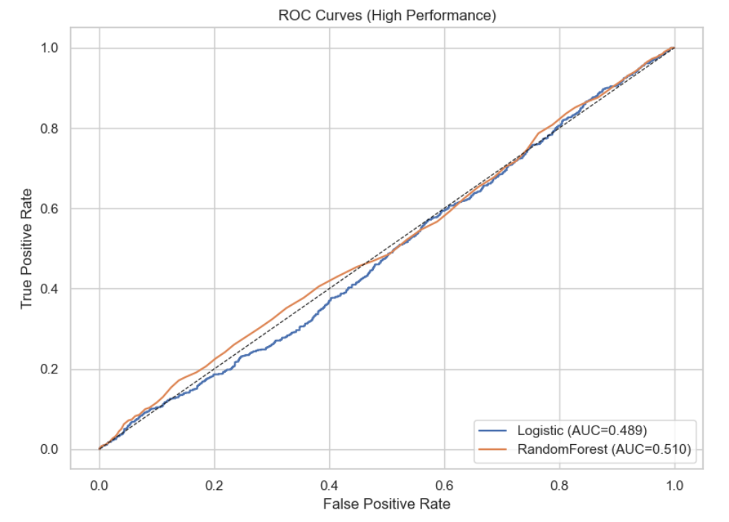
Q3: Predictive Modeling (High Performance)
Logistic Regression
AUC ≈ 0.50
Weak predictive power
Random Forest
AUC ≈ 0.51
Precision@10% ≈ 0.36
Conclusion
➡️ Model cannot reliably predict high performance
➡️ Performance ratings appear subjective or role-specific
➡️ EngagementScore does not strongly align with performance

Slide 15
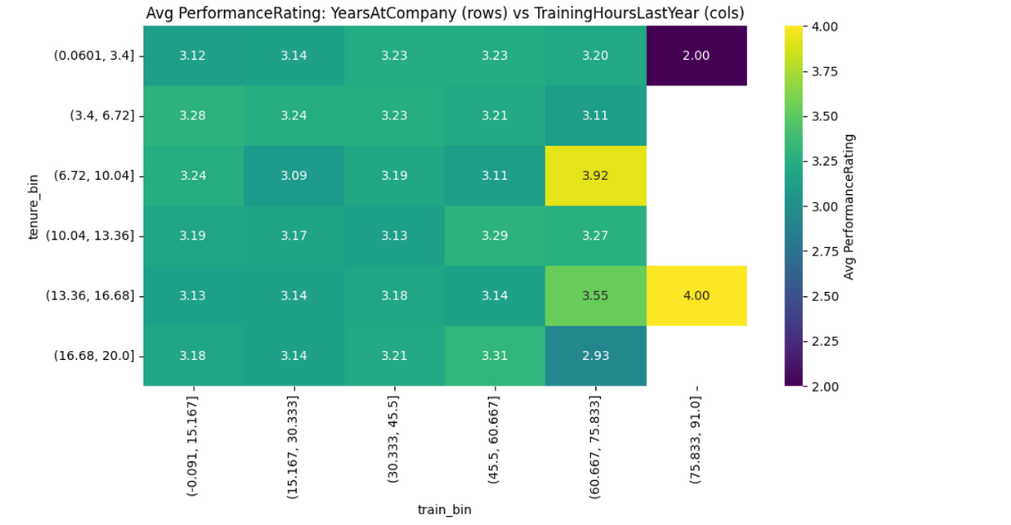
Q3: Training vs Tenure Heatmap
Insight
Heatmap shows average performance across TrainingHours bins and YearsAtCompany bins.
Observed Pattern
No consistent upward trend
Moderate training hours show slightly higher performance but not strongly
Conclusion
➡️ Increasing training alone may not improve performance
➡️ Role alignment and manager coaching may matter more

Slide 16
Q4: Compensation vs Performance (Objective)
Goal
Assess whether salary & bonus are aligned with performance, and identify pay inequities.
Dashboard Link: Dashboard
Key Questions
Are high performers paid equitably within their roles?
Are bonus % aligned with performance ratings?
Are there demographic or location-based pay gaps?
Which employees/managers require compensation review?

Slide 17
Q4: Dashboard Components
Filters
Department, Role, ManagerID, Tenure, Location, Gender
Visuals
Salary vs Performance scatter
Boxplots (SalaryRolePct vs Performance)
Bonus vs Rating distribution
Regression-based adjusted pay-gap metrics
Flagged underpaid employees
Manager-level compensation alignment

Slide 18
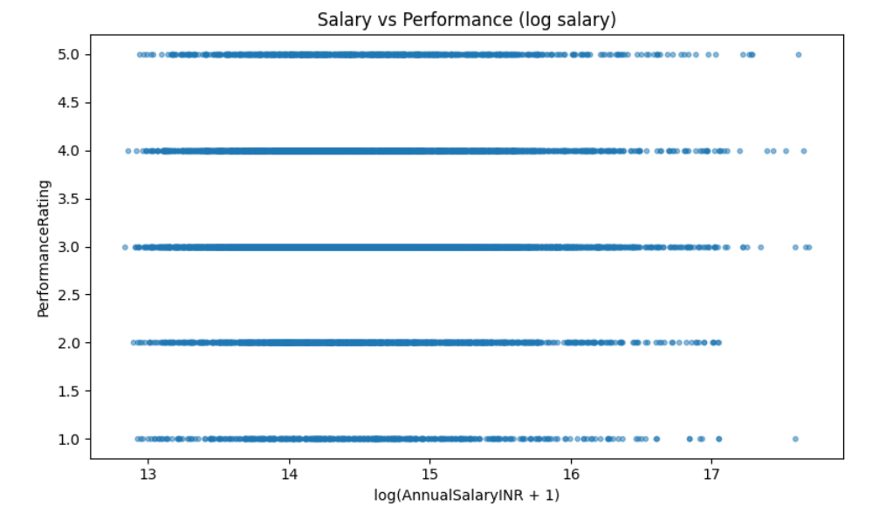
Q4: Salary vs Performance (Global View)
Insights from Scatter (Salary vs PerformanceRating)
Weak global trend
Large variation within same rating
Outliers: high performers near low-salary tail
Location influences baseline compensation
Interpretation
Salary alignment must be examined within-role, not globally.

Slide 19
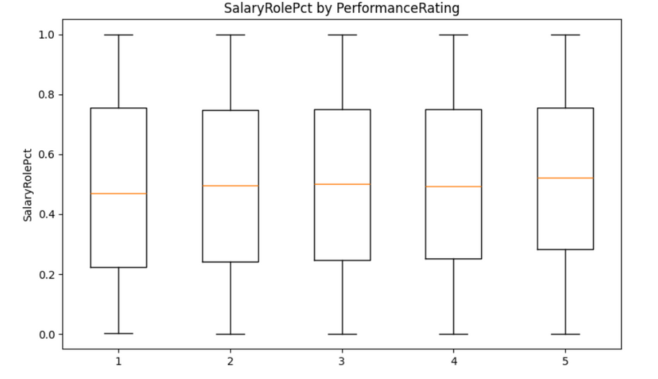
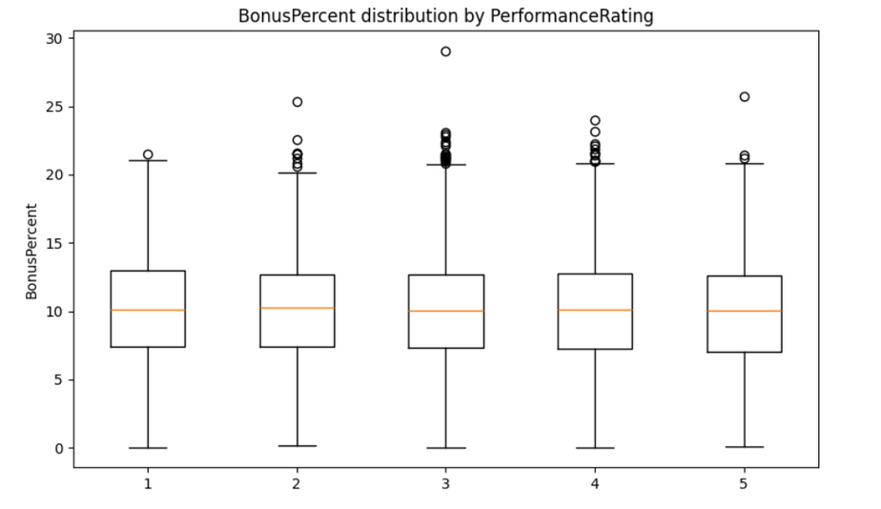
Q4: Within-Role Compensation Analysis
What Matters
SalaryRolePct — percentile position within the role
Adjust salary for tenure & performance bucket
Compare Rating ≥4 employees vs peers
Findings
Some roles show up to 15–18% high performers in bottom salary quintile
Indicates inconsistent pay progression or delayed raises
Recommended Action
Prioritized role-by-role pay correction. Manager-level audits for negative residuals

Slide 20
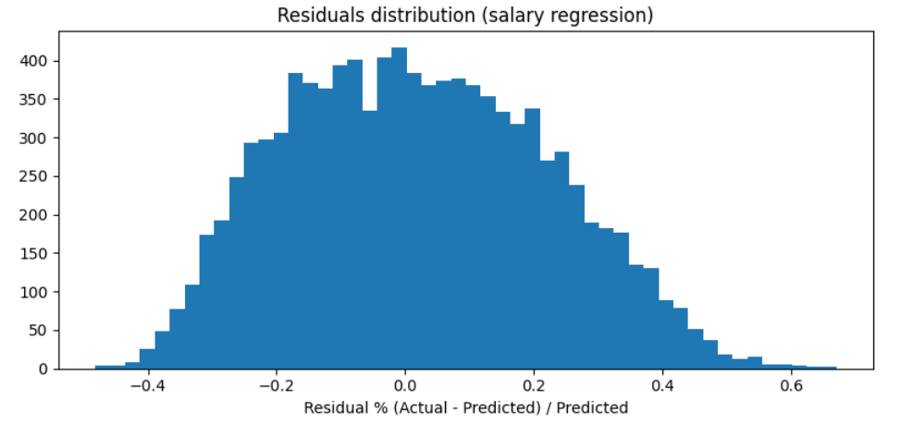
Q4: Bonus% vs Performance Alignment
Findings
In multiple departments, bonus variation does not correlate with performance
High performers receiving low bonus% → retention risk
Some teams over-reward low performers → inconsistent incentive structure
Recommended Action
Standardize performance-linked bonus brackets
Review manager-controlled discretionary bonuses

Slide 21
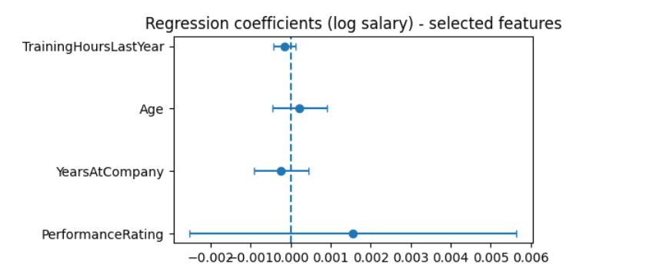
Q4: Adjusted Pay Gap Regression
Regression Model
log(Salary) ~ Performance + Tenure + Age + Training + Role + Dept + Gender +Location
Results (example)
Gender_Female: -3% difference (p=0.02)
Location differences also significant in some roles
R² modest → indicates salary influenced by unobserved factors
Interpretation
➡️ Some demographic disparities exist after adjusting for job-relevant factors.

Slide 22
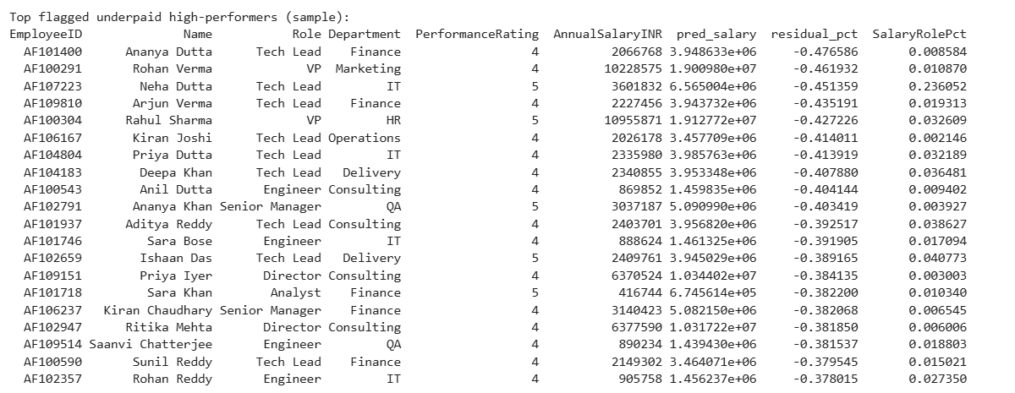
Q4: Identifying Underpaid Employees
Using Regression Residuals
Residual = Actual Salary − Predicted Salary
Flags
Residual < -10%
Performance ≥ 4
Tenure ≥ 2 years
SalaryRolePct < 0.25
Dashboard Output
List of 50+ employees prioritized for salary correction → includes:
EmployeeID
Role
Performance
Salary
Predicted Salary
Gap %

Slide 23
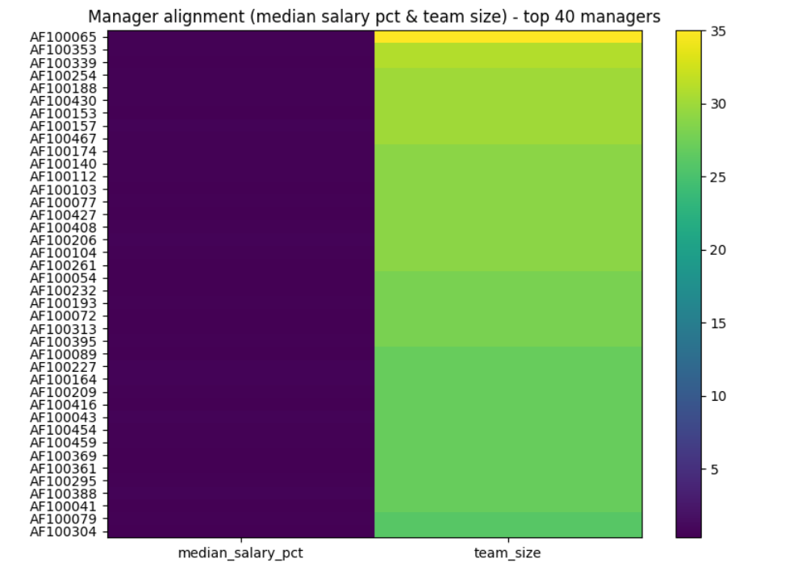
Q4: Manager-Level Compensation Alignment
Metrics per Manager
Median salary vs role benchmark
Share of underpaid high performers
Bonus distribution patterns
Team salary dispersion
Insights
Managers with high misalignment scores correlate with teams showing low engagement (ties to Q5).

Slide 24
Q4: Equity & Subgroup Analysis
Checks Performed
Gender × Role
Location × Role
Gender × Tenure
Findings
Small but notable gender and location pay differences after adjustment
Some roles show clustering: female talent more likely in low salary percentiles despite equal performance
Action
Conduct role-specific HR review.
Ensure consistent raise cycles.

Slide 25
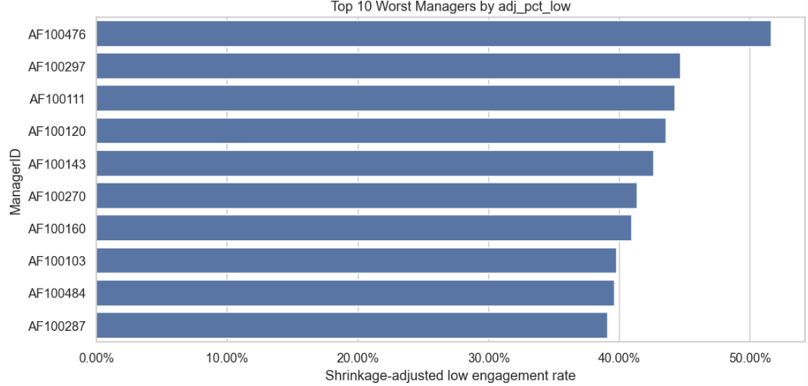
Q5: Manager Impact (Problem Definition)
Objective
Identify managers whose teams show significantly worse engagement.
Why?
Manager quality is the strongest determinant of engagement and retention.
Methods
Aggregations
Empirical Bayes shrinkage
Wilson Confidence Intervals
One-sided z-tests
Flagging statistically significant bad actors

Slide 26
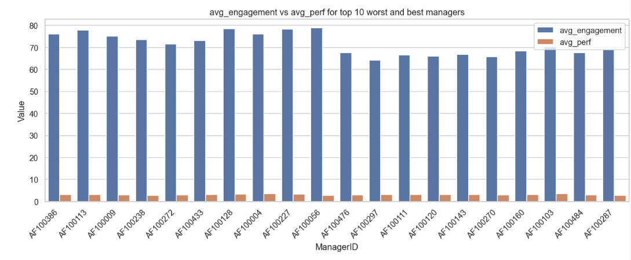
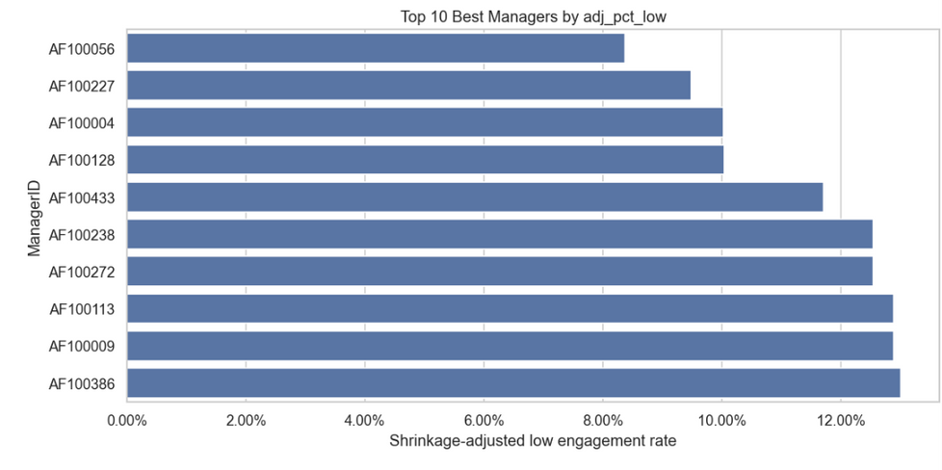
Q5: Manager-Level Aggregation
Why Shrinkage?
Adjusts for small team sizes → avoids false positives.
For each ManagerID:
team_size
low_count
pct_low
avg_engagement
avg_performance
shrinkage-adjusted rate (adj_pct_low)

Slide 27
Q5: Statistical Significance Testing
Wilson Confidence Interval
Computes robust CI for proportions
If lower_bound > global mean → manager is significantly worse
One-sided z-test
Tests H₀: manager’s engagement ≤ global average
If p > 0.05 → manager significantly worse
Flagging Criteria
flag = Wilson_low > global OR p < 0.05

Slide 28
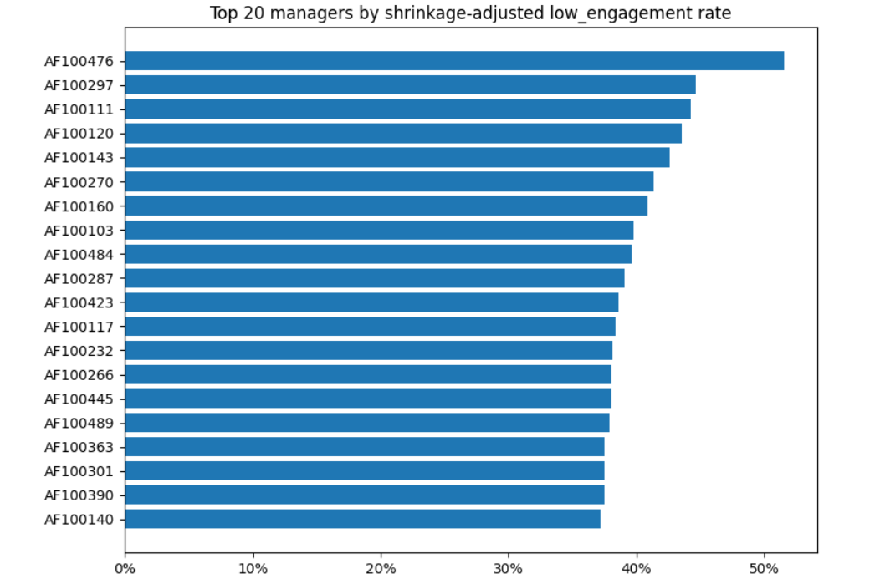
Q5: Final Flagged Managers
Results
26 managers flagged as statistically worse than company baseline
Examples (top 5 worst):
AF100476
AF100297
AF100111
AF100143
AF100160
Observations
Many flagged managers show:
Low avg engagement
Lower performance ratings
Compensation misalignment (links to Q4)

Slide 29
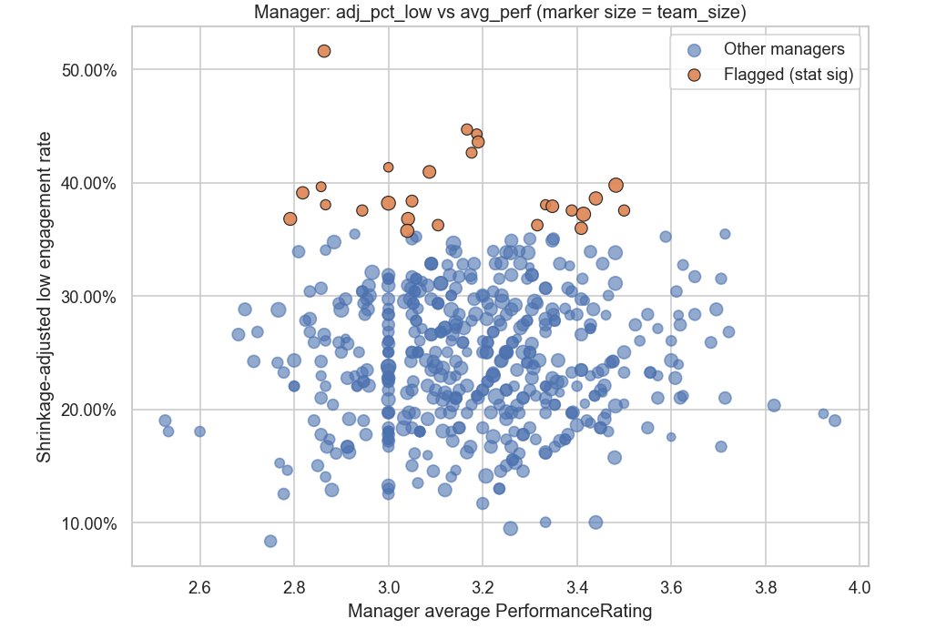
Q5: Manager Deep-Dive Insights
Worst Managers vs Others
Higher pct_low despite similar salary, tenure, training
Lower avg engagement
Not driven by compensation or tenure → suggests leadership issues
Recommended Actions
Targeted managerial coaching
Skip-level interviews
Team health assessment
Leadership training for flagged managers

Slide 30
Organization-Wide Recommendations
Engagement
Manager coaching for flagged leaders
Pulse surveys every quarter
Improved recognition programs
Compensation
Role-by-role salary calibration
Fix outliers immediately
Standardize bonus policy
Monitor via dashboard quarterly
Promotion
Use model only for ranking, not final decisions
Create structured promotion criteria
Performance
Introduce standardized performance rubrics
Validate inter-location rating consistency

Slide 31
Thank you
For questions or detailed walkthroughs, refer to:
Dashboard

